Slide 1
Security

Slide 2
Introduction
Information security field includes not only the security of information but it covers the security of all infrastructures related to computer system and internet.
Definition: The protection afforded to an automated information system in order to attain the applicable objectives of preserving the confidentiality, integrity and availability of information system resources (includes hardware, software, firmware, information/data, and telecommunications).

Slide 3
Security Components
CIA Triad
Confidentiality: Protection of data from unauthorized individuals
(Encryption)
Integrity: Assurance that data received are exactly as sent by an authorized sender.
(Hashing)
Availability: Assures that system works promptly and service is not denied to authorized users.

Slide 4
Additional Security Components
Authentication: The process of confirming or verifying that someone
is who he claim he is.
(Password)
Non-Repudiation: Assurance against denial by one of the parties in the communication.
(Digital Signature)
Access Control: This ensures that privileged access is withdrawn when privileges are revoked.

Slide 5
Cryptography, Computer Security and Network Security
Cryptography also called secret writing which is used to hide original message (plaintext, ciphertext, encryption, Casear, Vigenere)
Computer security includes the protection, prevention and detection of unauthorized use of computer systems as well as data stored in the computer.
Network security means protection of data on the network during transmission.

Slide 6
Steps for Better Security
Assets: Identify the important information which need to be protected.
Risks: Identify the threats, attacks, vulnerabilities and risks to the information.
Protections: To find out the solution for the protection of information.
Tools and techniques: Select the appropriate tools and techniques for the protection of information.
Priorities: Decide the order of the tools and techniques for the protection of information.

Slide 7
Security Techniques
Series of confidence
Access control
Ability to detect unpatched known flaws
Backup of data
Antivirus software
Firewalls
Encryption
Intrusion-detection systems (IDS)
Information security awareness

Slide 8
Hacking
A hacker is a person or a group of persons who creates, deletes and/or modifies software or hardware of the computer.
Hackers uses different tools to break the security of the computer system.
Ethical hacking and unethical hacking

Slide 9
Types of Hackers
White hat (ethical hacker): Use knowledge for the best of the society
Black hat (unethical hacker or cracker): break the security of the system for wicked intention
Grey hat: combination of white hat and black hat

Slide 10
Security Attacks
Security attacks can be defined as any action that compromises security of the computer systems or the information.
Passive attack: attacker tries to learn something from the data or to make use of information from the system.
Eavesdropping means unauthorized listening of the private communication of others without their consent.
Types: Release of message contents and traffic analysis
Active attack: attacker attempts to alter, change or modify the data or information.
Types: Masquerade, message reply, message modification, denial of service

Slide 11
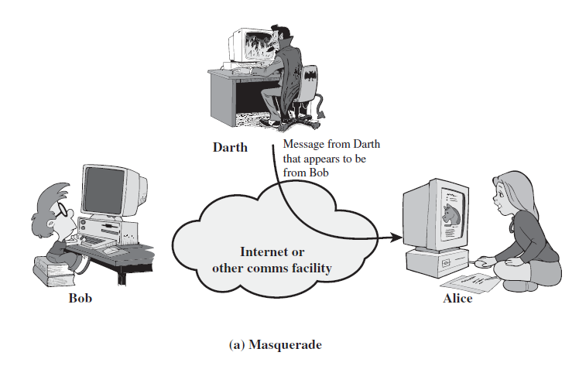
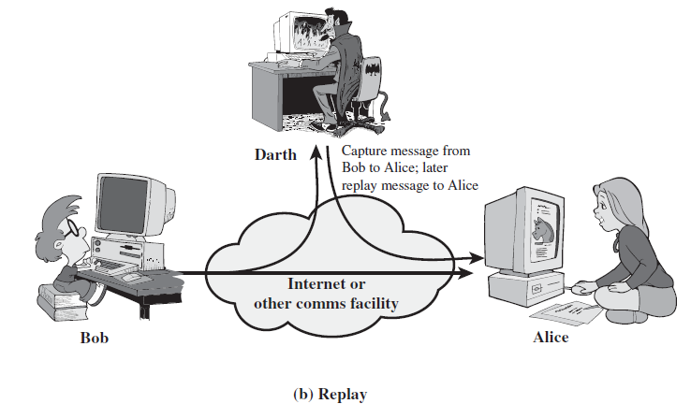
Types of Active Attacks
Notes:
Also have “active attacks” which attempt to alter system resources or affect their operation.
By modification of data stream to:
+ masquerade of one entity as some other
+ replay previous messages
+ modify messages in transit
+ denial of service
Active attacks present the opposite characteristics of passive attacks. Whereas passive attacks are difficult to detect, measures are available to prevent their success. On the other hand, it is quite difficult to prevent active attacks absolutely, because of the wide variety of potential physical,software,and network vulnerabilities. Instead, the goal is to detect active attacks and to recover from any disruption or delays caused by them.

Slide 12
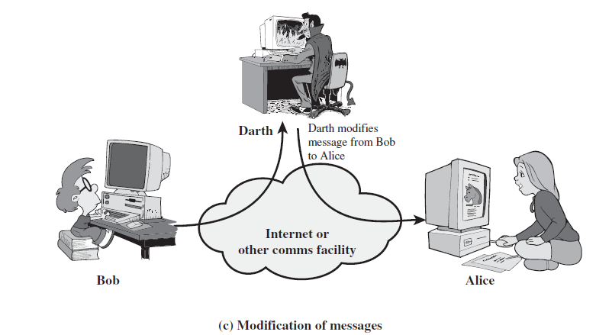
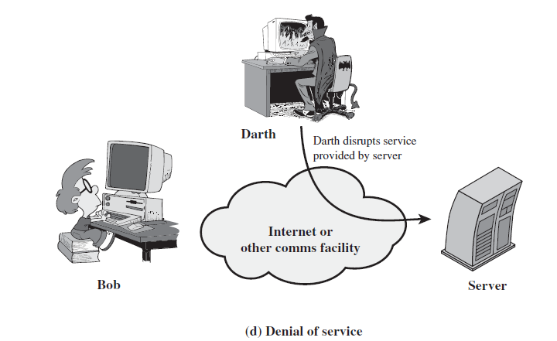
Types of Active Attacks

